Slide 1
C H A P T E R
3
INFORMATION SYSTEMS DEVELOPMENT
Notes:
Chapter 3 – Information Systems Development
This repository of slides is intended to support the named chapter. The slide repository should be used as follows:
Copy the file to a unique name for your course and unit.
Edit the file by deleting those slides you don’t want to cover, editing other slides as appropriate to your course, and adding slides as desired.
Print the slides to produce transparency masters or print directly to film or present the slides using a computer image projector.
Each slide includes instructor notes. To view those notes in PowerPoint, click-left on the View Menu; then click left on Notes View sub-menu. You may need to scroll down to see the instructor notes.
The instructor notes are also available in hardcopy as the Instructor Guide to Accompany Systems Analysis and Design Methods, 6/ed.

Slide 2
Chapter Three Information System Development
Describe the motivation for a system development process in terms of the Capability Maturity Model (CMM) for quality management.
Differentiate between the system life cycle and a system development methodology.
Describe 10 basic principles of system development.
Define problems, opportunities, and directives—the triggers for systems development projects.
Describe the PIECES framework for categorizing problems, opportunities, and directives.
Describe the essential phases of system development. For each phase, describe its purpose, inputs, and outputs.
Describe cross life cycle activities that overlap multiple system development phases.
Describe typical alternative “routes” through the basic phases of system development. Describe how routes may be combined or customized for different projects.
Describe various automated tools for system development.
Notes:
Chapter 3 – Information Systems Development
No additional notes

Slide 3
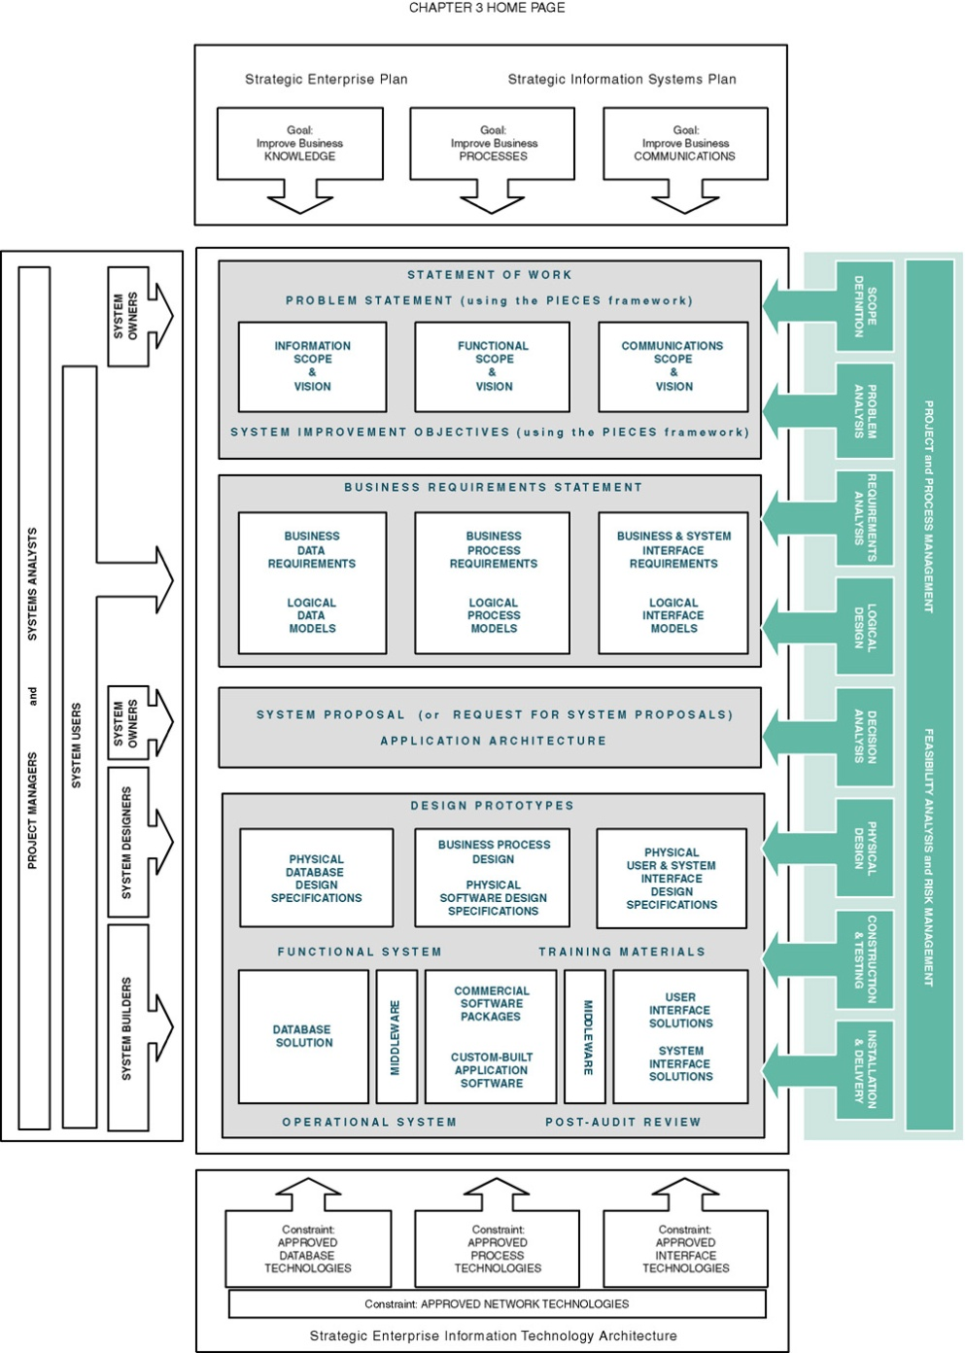
Chapter Map
Notes:
Chapter 3 – Information Systems Development
No additional notes.

Slide 4
System Development Process
Systems development process:
a set of activities, methods, best practices, deliverables, and automated tools that stakeholders use to develop and continuously improve information systems and software .
Using a standardized process:
  Create efficiencies that allow management to shift resources between projects
  Produces consistent documentation that reduces lifetime costs to maintain the systems
  Promotes quality: All US Gov. systems development requires certain quality management requirements such as CMM model.

Slide 5
The CMM Process Management Model
Capability Maturity Model (CMM) – a standardized framework for assessing the maturity level of an organization’s information system development and management processes.
  Highly recognized and famous model
  Developed by The Software Engineering Institute (SEI)
  Is being used to qualify IS developers for US federal Gov. projects.
CMM consists of five levels of maturity.
  Each level is a prerequisite for the next level.
Notes:
Chapter 3 – Information Systems Development
Conversion Notes
CMM was not covered in our competition at the time we wrote this material. We feel that it is very important. CMM is the information technology response to the total quality management initiative. CMM breathed new life into the importance of a system development process. The term “process” in CMM is equivalent to the term “methodology” as popularized in systems analysis and design methods.
Teaching Notes
Recognize that each level is a prerequisite for the next level.
Most organizations pursuing the CMM are targeting Level 3, that is, consistently using a standardized process or methodology to develop all systems.
CMM Level 2 deals with project management. CMM Level 3 deals with what has come to be known as process management.

Slide 6
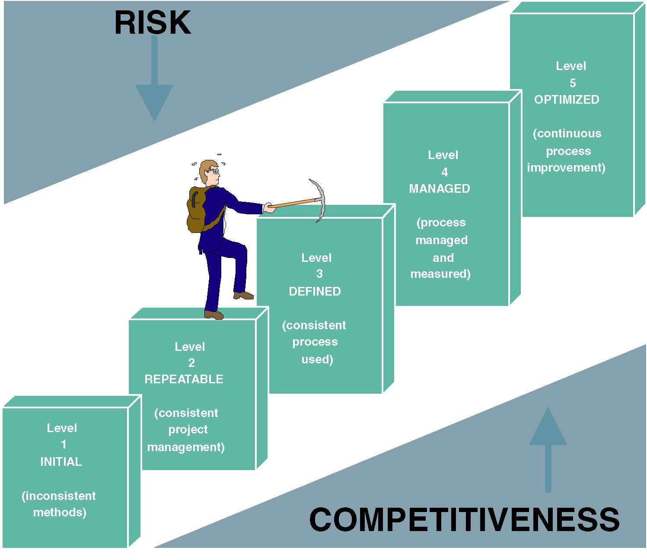
Capability Maturity Model (CMM)
Notes:
Chapter 3 – Information Systems Development
No additional notes

Slide 7
The CMM Process Management Model (con’t)
  Level 1—Initial: System development projects follow no prescribed process.
  Level 2—Repeatable: Project management processes and practices are established to track project costs, schedules, and functionality.
  Level 3—Defined: A standard system development process (sometimes called a “methodology”) is developed. All projects use a version of this process to develop and maintain information systems and software.
  Level 4—Managed: Measurable goals for quality and productivity are established (Not even MS….)
  Level 5—Optimizing: The standardized system development process is continuously monitored and improved based on measures and data analysis established in Level 4.

Slide 8
Impact of System Development “Process” on Quality
CMM Project Statistics for a Project Resulting in 200,000 Lines of Code
Organization’s CMM Level | Project Duration (months) | Project Person-Months | Number of Defects Shipped | Median Cost ($ millions) | Lowest Cost ($ millions) | Highest Cost ($ millions)
1 | 30 | 600 | 61 | 5.5 | 1.8 | 100+
2 | 18.5 | 143 | 12 | 1.3 | .96 | 1.7
3 | 15 | 80 | 7 | .728 | .518 | .933
Significant improvements in terms of schedule and cost at level 3
Thus, most organizations pursuing the CMM are targeting level 3.
Notes:
Chapter 3 – Information Systems Development
Conversion Notes
This table was in the 5th edition text but not in the 5th edition PowerPoints.
Teaching Notes
This table dramatically illustrates the value of following a methodology. Note the drop in project duration, person-months, defects, and costs as a result of following a consistent methodology

Slide 9
More about CMM model
Implications
  You CANNOT skip level
    It takes time to move from one level to the next
    Not many organization are above level 1
    Highly difficult to start at the level 3
  Esoteric new technology should be avoided at the lower levels (especially level 1 and 2)
  Starting level for the off-the-shelf systems
  The levels are already becoming important for contracts.

Slide 10
10 Commandments (Principles) of System Development
Get the system users involved.
Use a problem-solving approach (slide)
Establish phases and activities (slide)
Document through development
Establish standards
Manage the process and projects (slide)
Justify systems as capital investments (slide)
Don’t be afraid to cancel or revise scope (slide)
Divide and conquer.
Design systems for growth and change.
Next
Notes:
Chapter 3 – Information Systems Development
Conversion Notes
This list is expanded from the 5th edition.
Teaching Notes
Minicase #4, Century Tool & Die, has proven very effective for a class discussion of the principles of system development.

Slide 11
Use a Problem-Solving Approach
Back
Classical Problem-solving approach
  Study and understand the problem, its context, and its impact.
  Define the requirements that must be meet by any solution.
  Identify candidate solutions that fulfill the requirements, and select the “best” solution.
  Design and/or implement the chosen solution.
  Observe and evaluate the solution’s impact, and refine the solution accordingly.
Notes:
Chapter 3 – Information Systems Development
Conversion Notes
This slide is new in the 6th edition PowerPoints.
Teaching Notes
It can be useful to walk through a non-IS example of problem-solving, such as diagnosing a car problem or going to the restaurant store because you are hungry.

Slide 12
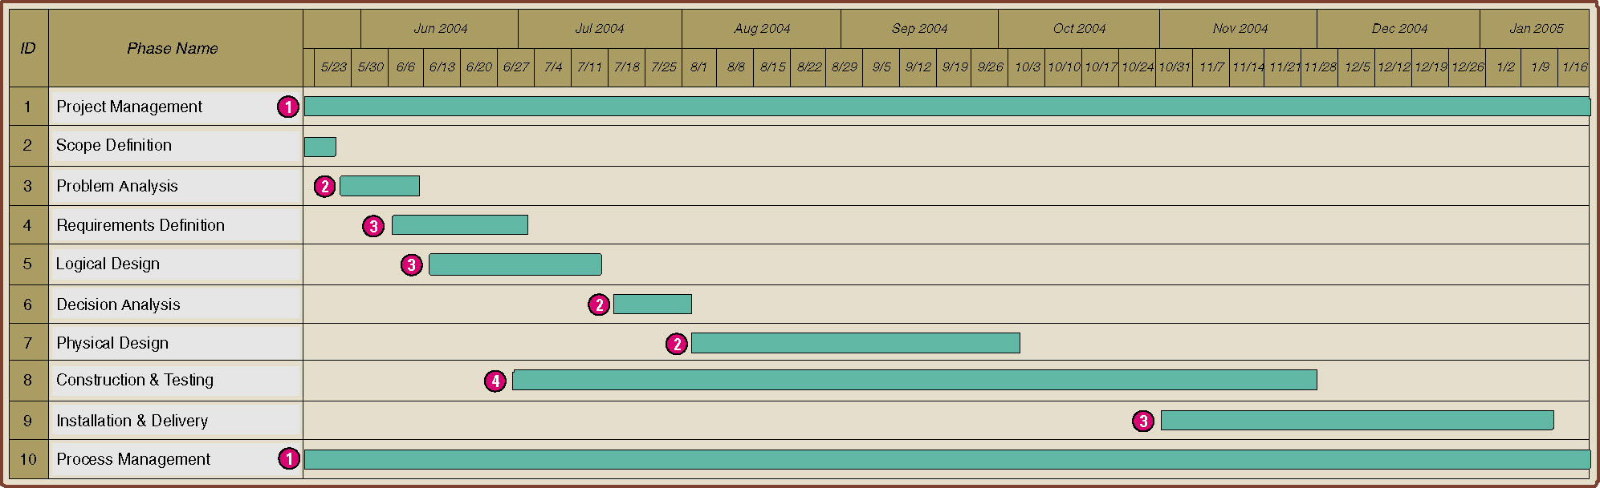
Establish Phases and Activities
Back
Overlap of System Development Phases
In real world, the phases tend to overlap one another.
Notes:
Chapter 3 – Information Systems Development
Teaching Notes
Every project is different depending on the size, complexity, and development methodology or route. The key point to emphasize in the figure is that the phases occur in parallel. It is important that students not misinterpret that the phases in this chapter are sequential.
Note that project and process management are illustrated as ongoing activities that last the duration of a project. (The next chapter will focus on project and process management as well as the construction and use of Gantt Charts such as the one above.)

Slide 13
Manage the Process and Projects
Back
Process management – an ongoing activity that documents, manages, oversees the use of, and improves an organization’s chosen methodology (the “process”) for system development. Process management is concerned with phases, activities, deliverables, and quality standards should be consistently applied to all projects.
Project management is the process of scoping, planning, staffing, organizing, directing, and controlling a project to develop an information system at a minimum cost, within a specified time frame, and with acceptable quality.
Notes:
Chapter 3 – Information Systems Development
Teaching Notes
Most organizations pursuing the CMM are targeting Level 3, that is, consistently using a standardized process or methodology to develop all systems. CMM Level 2 deals with project management. CMM Level 3 deals with what has come to be known as process management.

Slide 14
Justify Information Systems as Capital Investments
Back
Cost-benefit analysis through out the development process
    At each phase, reevaluate cost effectiveness, risk, and feasibility.
    Most system owners want more of their systems than they can afford or are willing to pay.
  Other extra advices..
    Should not blindly accept the first solution suggested
    Always evaluate each possible solution
Notes:
Chapter 3 – Information Systems Development
Conversion Notes
This slide is new in the 6th edition PowerPoints.

Slide 15
Don’t Be Afraid to Cancel or Revise Scope
Back
Cancel the project if it is no longer feasible
      possible???
Reevaluate and adjust the costs and schedule if project scope is to be increased.
      someone should be blamed…
Reduce the scope if the project budget and schedule are frozen and not sufficient to cover all project objectives.
Manage feasibility throughout the project in order to control risks.
Notes:
Chapter 3 – Information Systems Development
Conversion Notes
This slide is new in the 6th edition PowerPoints.

Slide 16
A System Development Process
Systems owners and users usually initiate projects
Usually use a framework to identify problems
  PIECES
    Practical framework to identify problems
    The categories of the PIECES framework tend to overlap one another.
Notes:
Chapter 3 – Information Systems Development
Teaching Notes
Emphasize that problems, opportunities, and directives can either be planned or unplanned.

Slide 17
The PIECES Problem-Solving Framework
P the need to improve performance
I the need to improve information (and data)
E the need to improve economics, control costs, or increase profits
C the need to improve control or security
E the need to improve efficiency of people and processes
S the need to improve service to customers, suppliers, partners, employees, etc.
Notes:
Chapter 3 – Information Systems Development
Teaching Notes
We really emphasize PIECES as a useful way to characterize all problems. Later, we teach our students to use PIECES to analyze requirements and solutions as well.
It can be useful to apply the PIECES framework to a project from the instructor’s professional background.
Refer to Figure 3-4 in the text for the PIECES checklist.

Slide 18
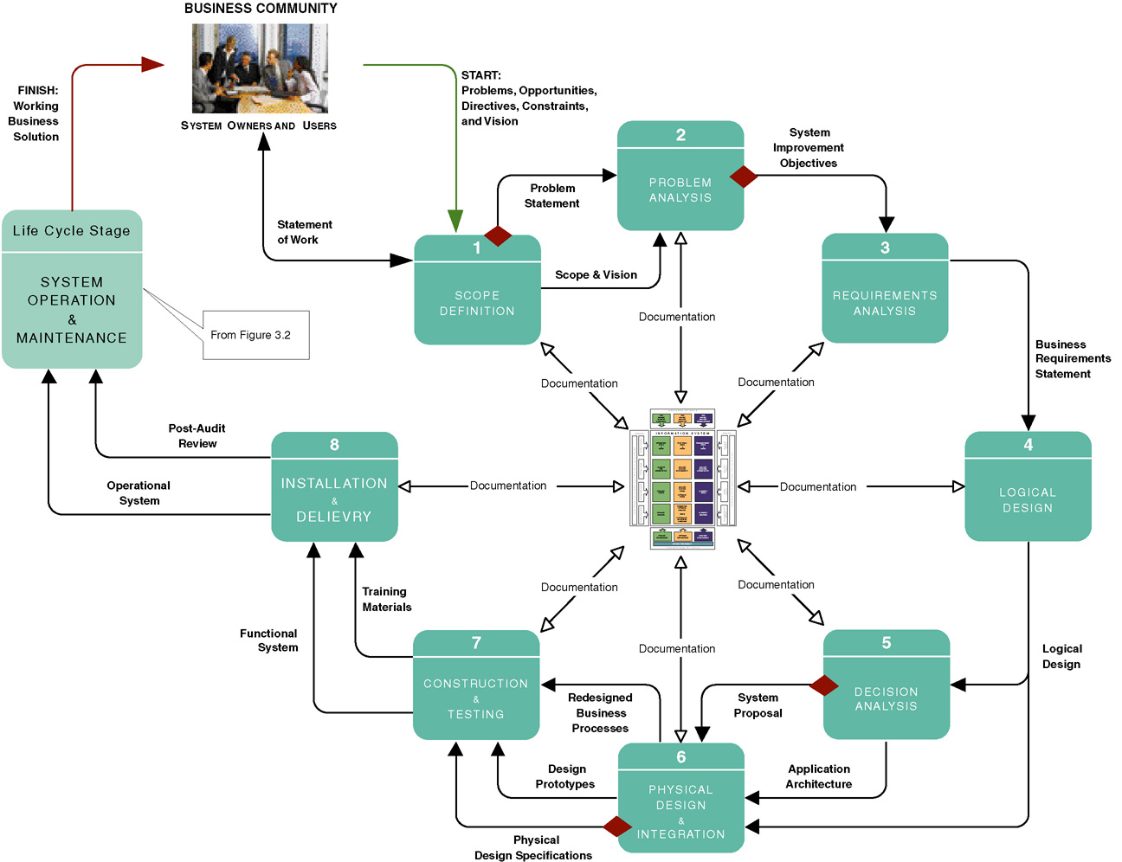
The Classic Project Phases (using FAST methodology)
Notes:
Chapter 3 – Information Systems Development
Teaching Notes
This is not meant to be interpreted as a “waterfall” model.
Make sure that the students recognize that this slide represents one methodology that the authors call FAST. There are many methodologies and variations on this slide.
Note that documentation goes on at every phase. These are the “deliverables” of the project.
The diamonds reflect typical “go” or “no go” feasibility checkpoints consistent with the creeping commitment philosophy.
At the center of the figure is the Building Blocks View of System Development, shown on the next slide.

Slide 19
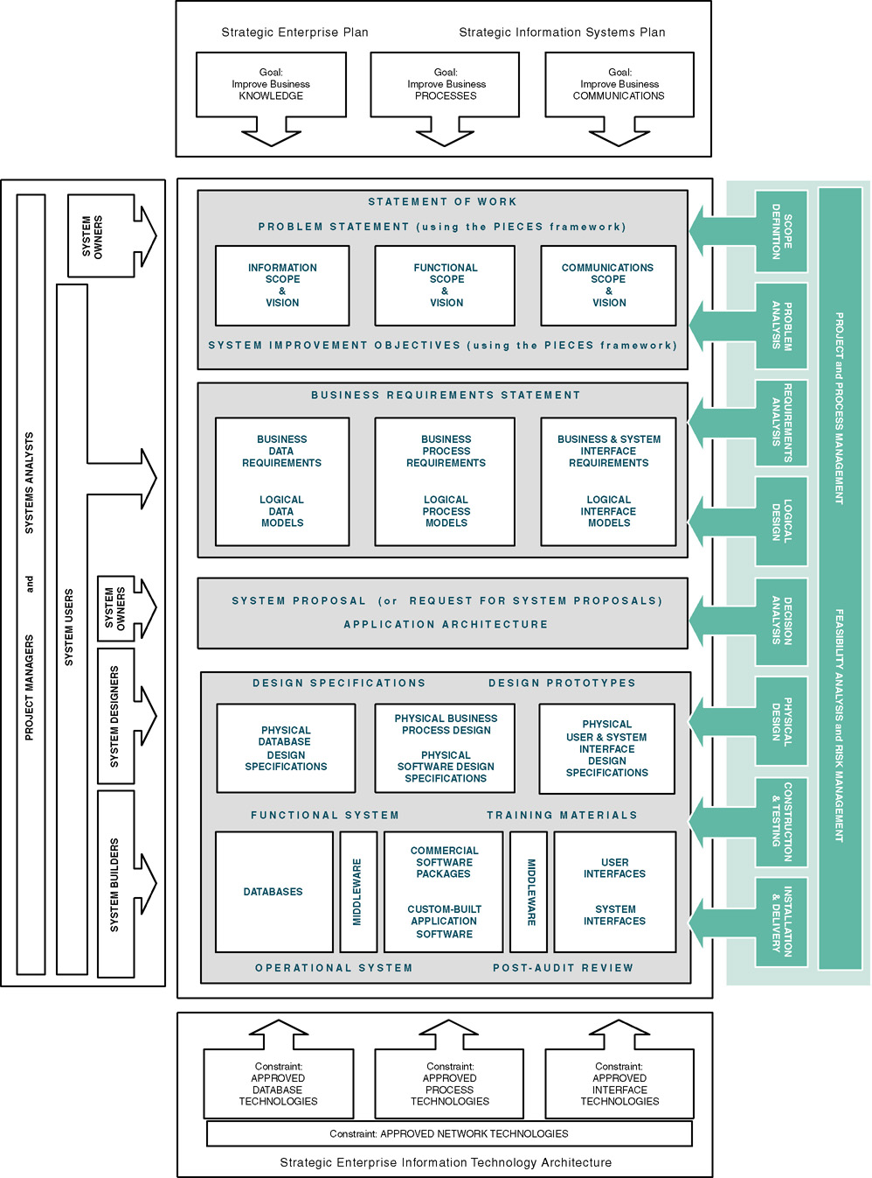
Building Blocks View of System Development
Shows corresponding participants for each phase
Notes:
Chapter 3 – Information Systems Development
Conversion Notes
This is new in the 6th edition.
Teaching Notes
This figure details all the deliverables of the FAST methodology throughout the project as well as the interaction with the project of all system users and the timing of each FAST phase.
Note also the role of the strategic enterprise plan, strategic information systems plan, and strategic enterprise information technology architecture.
You can use this figure to walk students through the syllabus, showing where each chapter and each case study deliverable fits in.

Slide 20
Scope Definition
Two objectives
  Is this problem worth looking at?
  If the problem is worth looking at, establish the size and boundaries of the project, the project vision, any constraints or limitations, the required project participants, and, finally, the budget and schedule.
  Participants
    systems owners, SA, and project managers
  Deliverables
    A problem statement and an initial scope statement
Notes:
Chapter 3 – Information Systems Development
Conversion Notes
This slide is new in the 6th edition PowerPoints.

Slide 21
Problem Analysis
Objective
  Study the existing system and analyzes the findings to provide the project team with a more thorough understanding of the problems that triggered the project.
  Answer the most important question,“Will the benefits of solving these problems exceed the costs of building the system to solve these problems?”
  Participants
    systems owners, SA, and project managers
  Deliverables
    A system improvement objective
    Ex) reduce the time between order processing and shipping by three days
Notes:
Chapter 3 – Information Systems Development
Conversion Notes
This slide is new in the 6th edition PowerPoints.

Slide 22
Requirements Analysis
Objective
  Define and prioritize the business requirement: find out what users need or want out of the new system.
    Perhaps the most important phase of systems development.
  Errors and omissions in requirements analysis →
    result in user dissatisfaction with the final system and costly modifications.
  Participants
    system users, SA, and project managers
  Deliverables
    Business requirements statement
Notes:
Chapter 3 – Information Systems Development
Conversion Notes
This slide is new in the 6th edition PowerPoints.

Slide 23
Logical Design
Objective
Translate business user requirements into a system model
Develop a conceptual model
  Process model
  Data Model
  interface model
  Participants
    SA (draw model)
    System users (validate model)
    Project managers
  Deliverables
    Logical system models and specifications
Notes:
Chapter 3 – Information Systems Development
Conversion Notes
This slide is new in the 6th edition PowerPoints.

Slide 24
Decision Analysis
Evaluate candidate solutions in terms of:
  Technical feasibility – Is the solution technically practical? Does our staff have the technical expertise to design and build this solution?
  Operational feasibility – Will the solution fulfill the users’ requirements? To what degree? How will the solution change the users’ work environment? How do users feel about such a solution?
  Economic feasibility – Is the solution cost-effective?
  Schedule feasibility – Can the solution be designed and implemented within an acceptable time?
  Risk feasibility – What is the probability of a successful implementation using the technology and approach?
Participants
  system owners, SA, and project managers
Deliverables
  System proposal and application architecture
Notes:
Chapter 3 – Information Systems Development
Teaching Notes
These will be covered in detail in Chapter 10.

Slide 25
Physical Design & Integration
Objective
Translation of business user requirements into a system model that depicts a technical implementation of the users’ business requirements.
Two philosophies of physical design
  Design by specification – physical system models and detailed specification are produced as a series of written (or computer-generated) blueprints for construction.
  Design by prototyping – Incomplete but functioning applications or subsystems (called prototypes) are constructed and refined based on feedback from users and other designers.
Participants
  system desingers, system builders, SA, and project managers
Deliverables
  Design prototypes and physical specifications
Notes:
Chapter 3 – Information Systems Development
No additional notes.

Slide 26
Rest of the development phases
Construction and Testing
Installation and Delivery
System Operation and Maintenance
Notes:
Chapter 3 – Information Systems Development
No additional notes.

Slide 27
System Development Strategies (Will be discussed at Ch 5)
A taxonomy for systems development methodologies and strategies (slide)
Model-driven Development Strategy – a system development strategy that emphasizes the drawing of system models to help visualize and analyze problems, define business requirements, and design information systems.
  Process modeling, Data modeling, and Object modeling
  Often criticized for its time and effort intensity, model-driven development strategy work well with large/complex projects and structured domain problems.
  Next
Notes:
Chapter 3 – Information Systems Development
Teaching Notes
The model-driven “route” is most typically associated with “methodologies based on structured analysis and design, information engineering (data modeling), or object-oriented analysis and design (use-case, UML, etc.).
It was not the intent to teach the techniques in this chapter. That is why we elected not to include sample models that the students would not truly understand until they read the modeling chapters themselves.

Slide 28
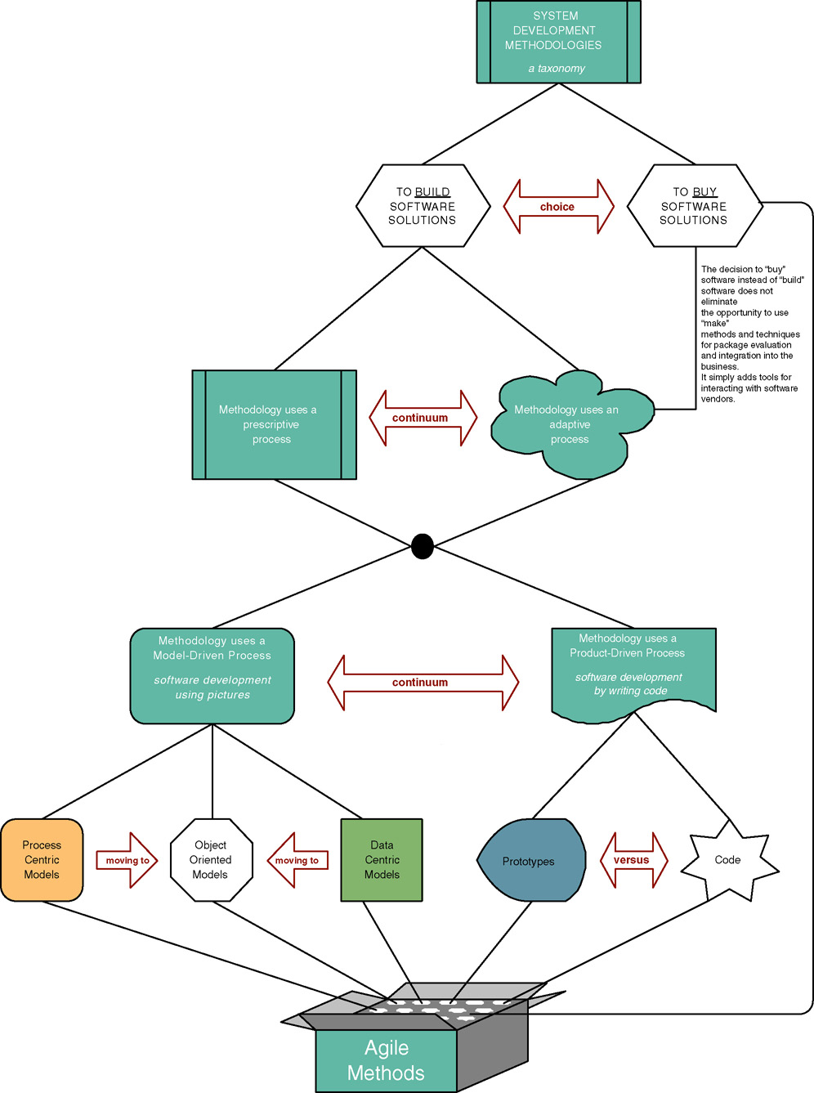
A Taxonomy for System Development Methodologies & Strategies
Back
Notes:
Chapter 3 – Information Systems Development
Teaching Notes
There can be multiple strategies or “routes” through the traditional phases. Thus, “one size does not fit all projects.”
We have included a few of the more common routes, but there are literally dozens of routes and hundreds of variations in many methodologies.
A key precept is that, contrary to popular marketing and consulting hype, the routes are merely different implementations of the same basic phases already covered (usually cleverly disguised in proprietary languages and terminology). Different routes emphasize different phases, tools, and techniques.

Slide 29
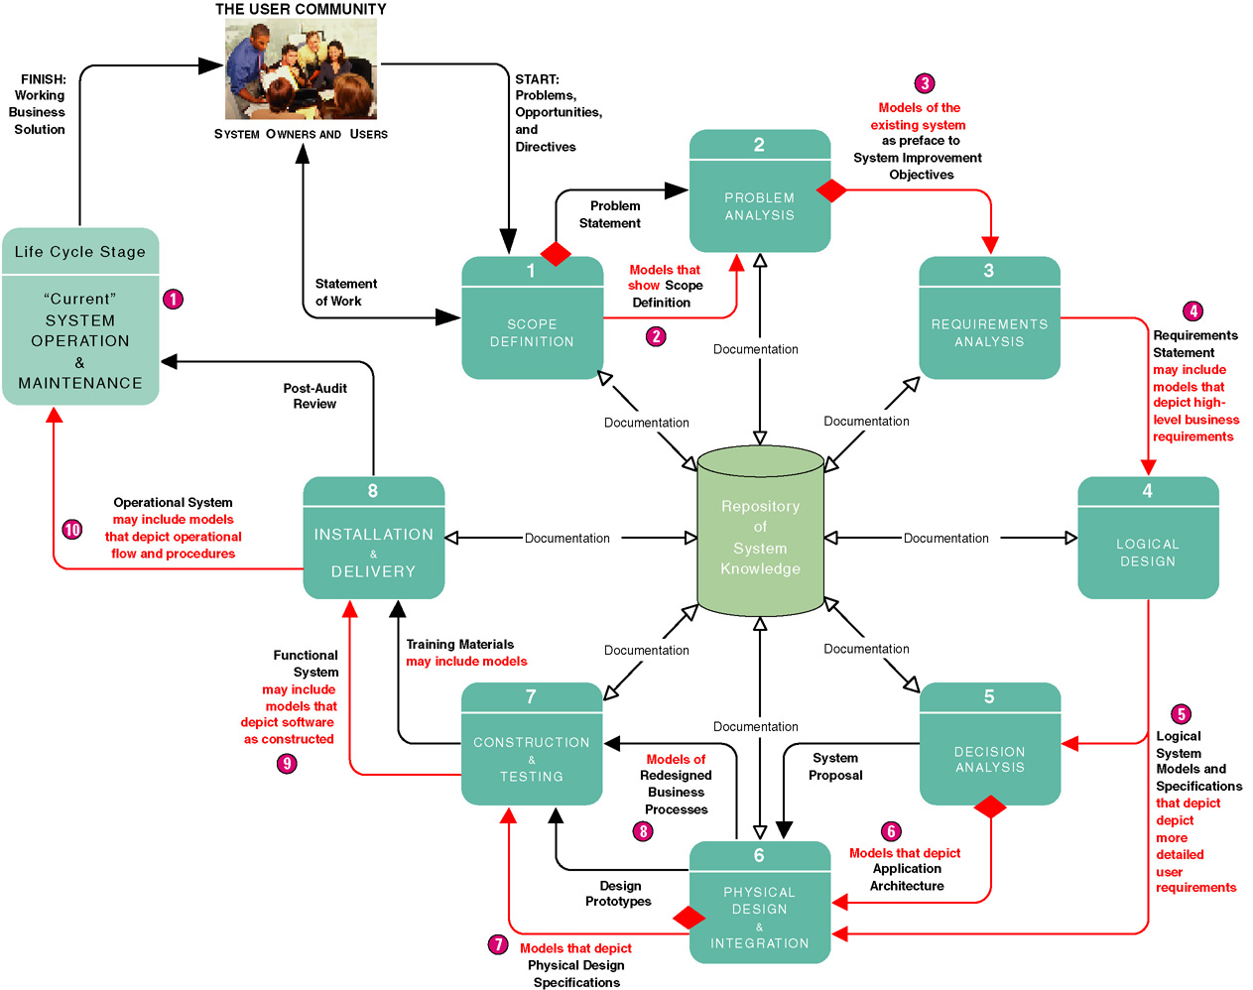
Model-Driven Development Strategy
Notes:
Chapter 3 – Information Systems Development
Teaching Notes
The model-driven approach (with the notable exception of OOAD) is most commonly associated with the “waterfall” approach to system development. While often criticized for its time and effort intensity, model-driven strategies still work well with large and unstructured problem domains.

Slide 30
Rapid Application Development Strategy
Rapid application development (RAD) – a system development strategy that emphasizes speed of development through extensive user involvement in the rapid, iterative, and incremental construction of series of functioning prototypes of a system that eventually evolves into the final system.
  Prototype – a small-scale, representative, or working model of the users’ requirements or a proposed design for an information system.
  Suitable if domain is not well defined (semi or unstructured)
  Useful if technical requirements are unclear.
  Not appropriate for large and complex technical systems
  Design problem due to rapid development
Notes:
Chapter 3 – Information Systems Development
Teaching Notes
The rapid application development “route” is most typically associated with prototyping, JAD, and incremental or iterative approaches to system development.

Slide 31
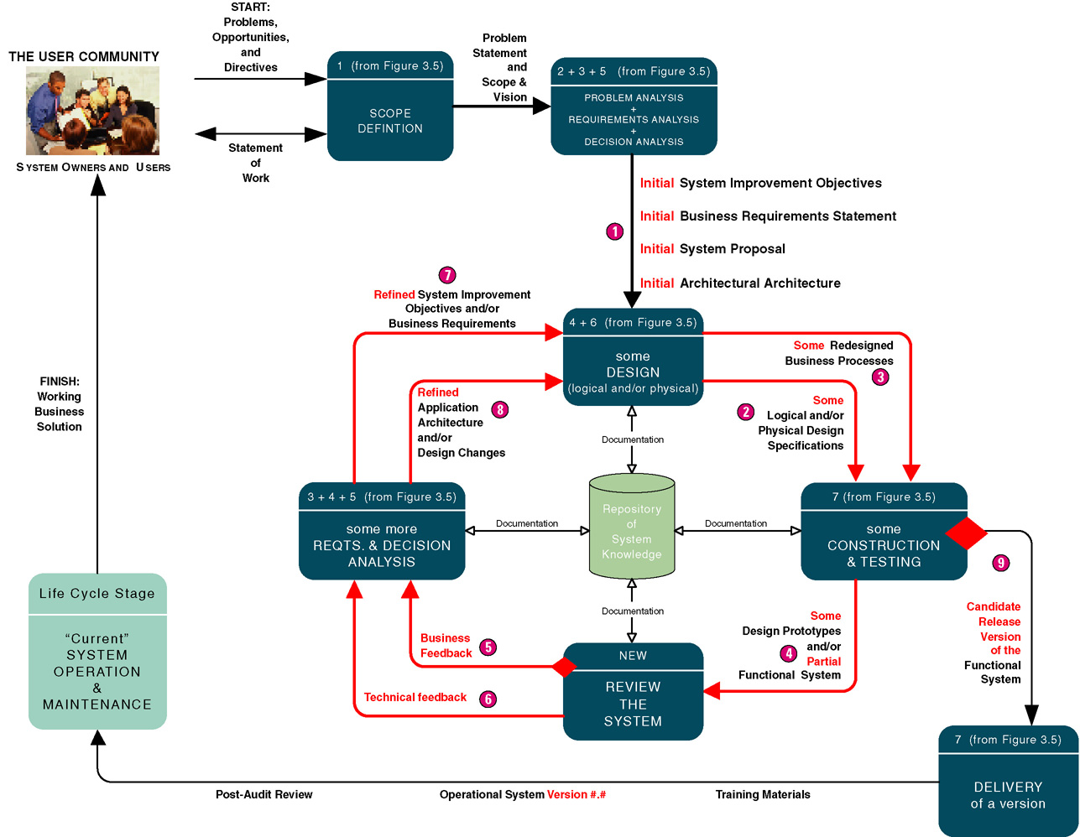
Rapid Application Development Strategy
Notes:
Chapter 3 – Information Systems Development
Teaching Notes
The rapid application development approach is most commonly associated with an incremental or iterative approach to system development. It is very popular for smaller and relatively structured projects in which requirements are fairly well understood from the beginning of the project.

Slide 32
Commercial Application Package Implementation Strategy
Commercial application package – a software application that can be purchased and customized to meet the business requirements of a large number of organizations or a specific industry. A synonym is commercial off-the-shelf (COTS) system.
  Save development costs
  Existing capabilities are limited (e.g., short of technological ability and IS staff)
  Systems that do not related with organization's secret
  To learn about more advanced technologies
ERP vendors provide their own implementation strategy.
  Change of business processes after implementation
Notes:
Chapter 3 – Information Systems Development
Conversion Notes
COTS has become extraordinarily important to aspiring systems analysts because an ever-increasing percentage of all information systems are purchased, not built in-house.
This edition of the textbook includes new chapters that specifically focus on software procurement and systems integration caused by software procurement.
Teaching Notes
Emphasize to students that tomorrow’s systems analysts will be as likely to participate in a software package selection and integration as they will in a traditional design-and-construction style project.

Slide 33
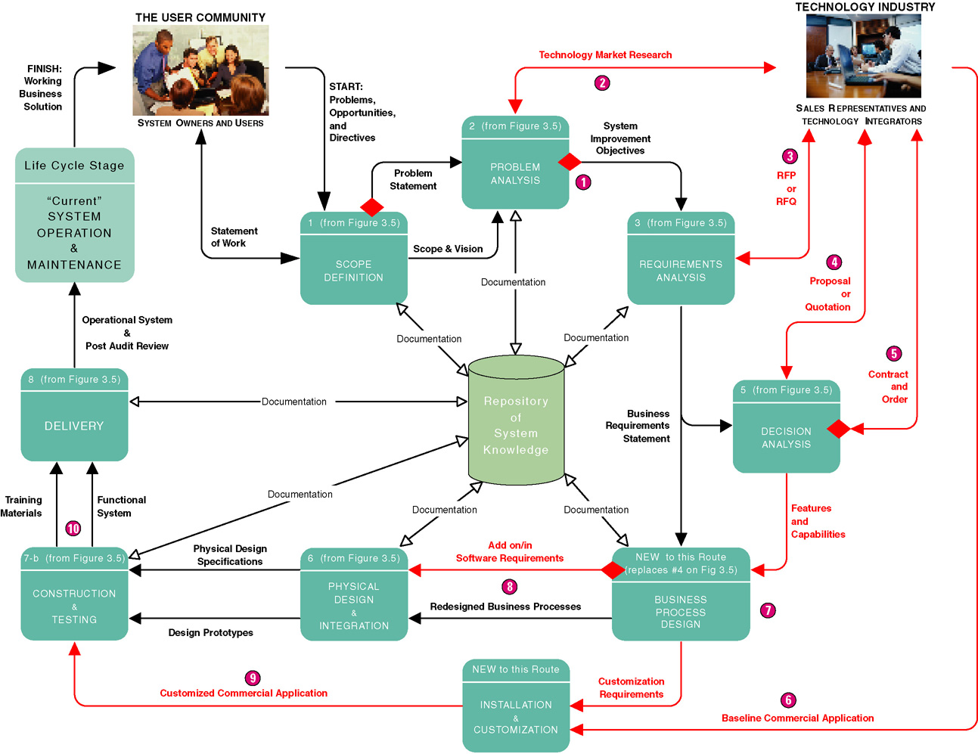
Commercial Application Package Implementation Strategy
Notes:
Chapter 3 – Information Systems Development
Teaching Notes
This slide depicts a typical project to select a software package and then integrate that package into a business (and its other existing information systems).
In the chapter, we specifically omitted ERP applications from this COTS route. ERP applications are so large and complex that their vendors typically provide a custom methodology (and consulting) to implement the ERP solution.
The COTS route looks more complex because few software packages fulfill 100 percent of an organizations requirements. Thus, a COTS project does not preclude traditional analysis, design, and construction activities to supplement capabilities not provided by the chosen software package.
Additionally, most software packages require customization that requires additional requirements analysis, design customization, and programming within the application’s embedded language.

Slide 34
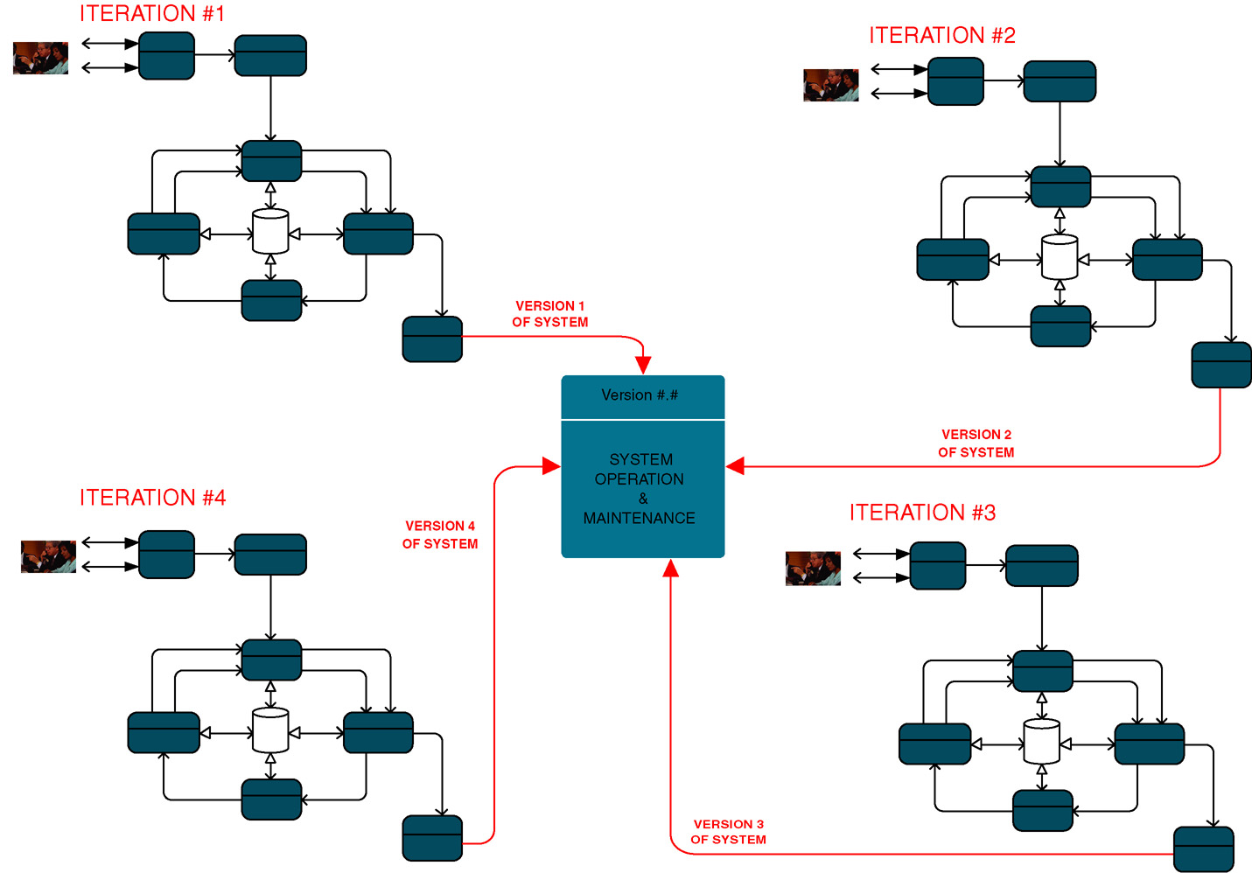
Hybrid Strategies
Notes:
Chapter 3 – Information Systems Development
Teaching Notes
This is one possible hybrid strategy using an incremental strategy in combination with rapid application development.

